Slide 1
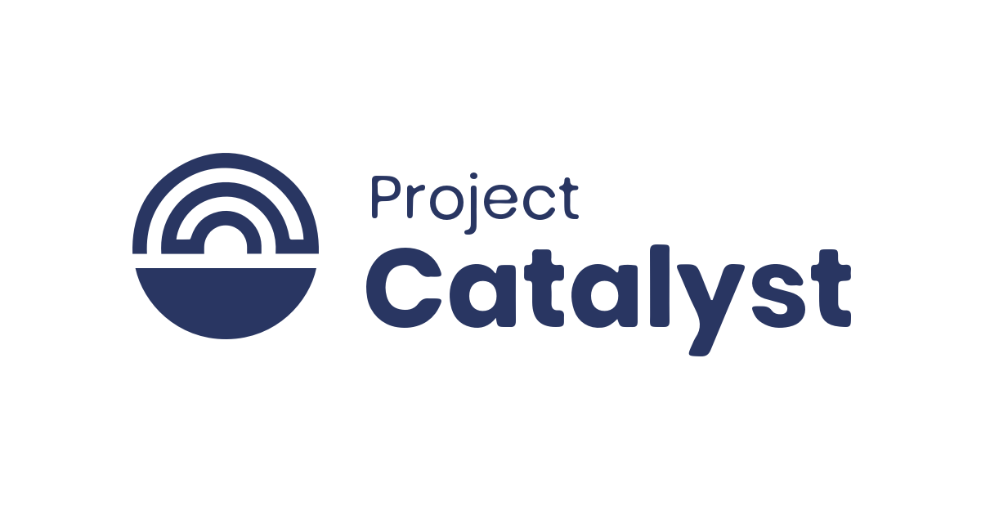
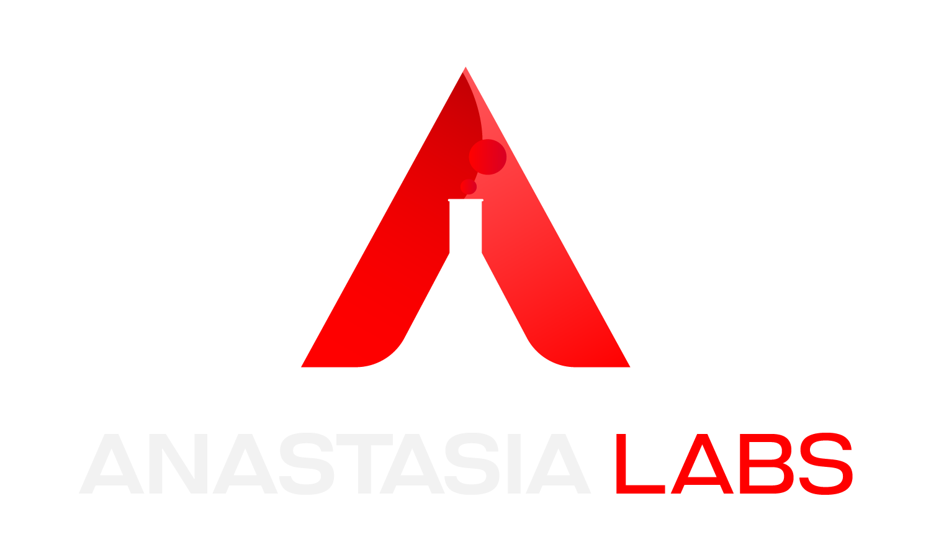
The Trifecta of Data Structures: Merkle Trees, Tries, and Linked Lists for Cutting-Edge Contracts
Fund 10
Fund 10

Slide 2
Challenge
To address the scalability challenges due to constraints like the single UTxO model and the 16-kilobyte (KB) transaction size limit.
To address the absence of shared design patterns as well as limited practical examples and educational resources for scaling solutions in the Cardano community.

Slide 3
Project Objectives
To design and develop efficient data structures for the Cardano Blockchain in Aiken and Plutarch.
Merkle Trees
Linked Lists
Tries
To ensure these data structures go through rigorous testing and are production-ready.
To provide detailed, easy-to-follow documentation to help developers implement these structures.

Slide 4
Execution and Milestones
We divided our project into three phases.
Design and Development
Testing
Documentation

Slide 5


Phase 1: Design and Development
We successfully designed and developed the data structures in both Aiken and Plutarch:
Why Aiken?
Aiken is particularly known for its expressive syntax, strong typing system, and rapid community adoption.
Why Plutarch?
Plutarch is known for its ability to manipulate outcomes at a lower level (close to UPLC), which enabled control over the execution of smart contracts.

Slide 6
Why Merkle Trees?
It is valuable in providing the presence of arbitrary data within the tree structure. By carrying only the root hash in the script, an effective and space-saving proof can be generated, ensuring data integrity and validity.
Merkle Root
|
+---------------+---------------+
| |
Hash(A+B) Hash(C+D)
| |
+-----+-----+ +-----+-----+
| | | |
Hash(A) Hash(B) Hash(C) Hash(D)

Slide 7
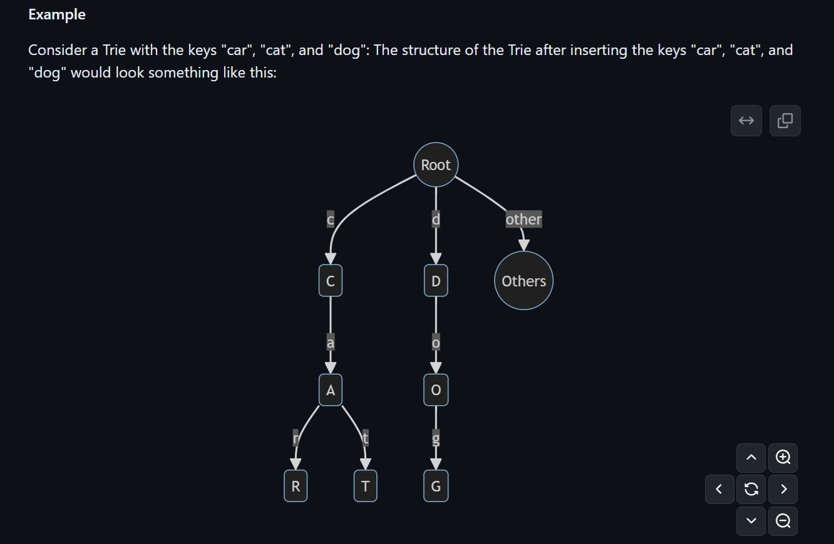
Why Trie?
It is useful in facilitating mutable data storage in script by leveraging the sharing of common prefixes. This approach optimizes storage efficiency and enables more extensive data manipulation within the constrained on-chain environment.

Slide 8
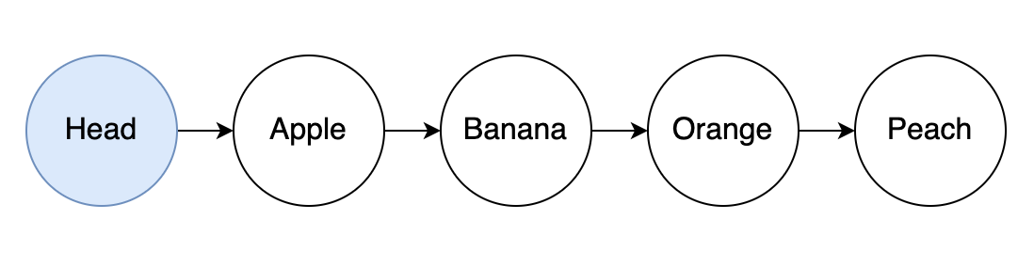
Why Linked Lists?
It leverages the EUTxO model to significantly enhance scalability and throughput. By linking multiple UTxOs together through a series of minting policies and validators, it improves the user experience interacting with smart contracts concurrently.

Slide 9
Phase 2: Tests
Each data structure was subjected to both manual code reviews and unit tests, with the results integrated into CI/CD pipeline. We ensured that they all passed the unit tests.

Slide 10
Phase 3: Documentation
We created user-friendly documentation to help developers of all skill levels understand and implement the data structures we developed. Our documentation includes;
Merkle Tree: Below is an aiken execution demo of Merkle Tree. Detailed guides and practical examples can be found at:
Aiken: https://github.com/Anastasia-Labs/aiken-merkle-tree
Plutarch: https://github.com/Anastasia-Labs/plutarch-merkle-tree

Slide 11
Trie: Following the Aiken execution demo, the step by step instructions and tutorials can be found here: Aiken: https://github.com/Anastasia-Labs/aiken-trie
Plutarch: https://github.com/Anastasia-Labs/plutarch-trie
P

Slide 12
Linked Lists: Below is the Linked Lists execution demo. Clear diagrams and examples can be found: Aiken: https://github.com/Anastasia-Labs/aiken-linked-list
Plutarch: https://github.com/Anastasia-Labs/plutarch-linked-list
P

Slide 13
Achievements
P
Implementation of advanced data structures (Merkle Trees, Tries and Linked Lists) in Aiken and Plutarch.
Extensive documentation and tutorials to enrich the Cardano community with educational resources and scaling solutions.
Some of the data structures are already in use by some industry leaders such as Sundae Labs, where they use Linked Lists for their Single Asset Staking library and their Taste Test mechanism.
Quality assurance through rigorous code reviews and comprehensive unit tests.
P

Slide 14
Key Learnings
P
Efficiency and data integrity with Merkle Trees
Flexibility and efficiency with Linked Lists
Managing mutable data with tries
Further experience with Aiken and Plutarch
P

Slide 15
Future Prospects and Community Impact
P
Sparking Interest and Collaboration
Continuous Improvement
Documentation Improvement
Long-Term Commitment
P

Slide 16
Conclusion
P
The project has bridged the gap of lack of scaling resources by providing essential data structures and comprehensive documentation
These tools will enhance the scalability of Cardano based Apps
P
Links:
P
Trifecta of Data Structures: https://github.com/Anastasia-Labs/data-structures
Anastasia Labs: https://anastasialabs.com
Twitter / X: https://x.com/AnastasiaLabs
Discord: https://discord.com/invite/8TYSgwthVy
G
P

